Slide 1
CS559 Machine Learning
Final Project Report
Team Members:
Sanjeet Jain
Savil Dsouza
Kshitij Patil

Slide 2

Contents
Introduction
Workflow Summary
Model Results
Conclusion

Slide 3


Data Preprocessing: Cleaning Up the Data for Analysis
Handling Missing Values
Treating Outliers
Addressing Inconsistencies
Overall, we performed data preprocessing on the provided datasets to ensure the data was clean and ready for analysis.

Slide 4
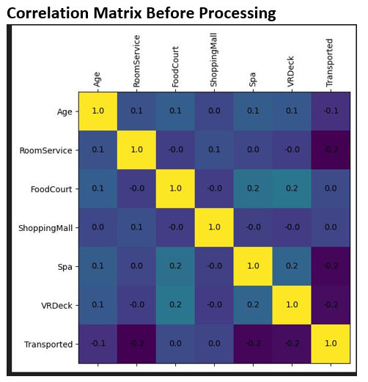

Slide 5
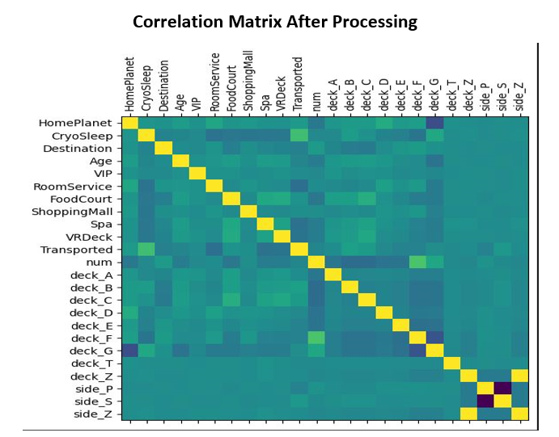
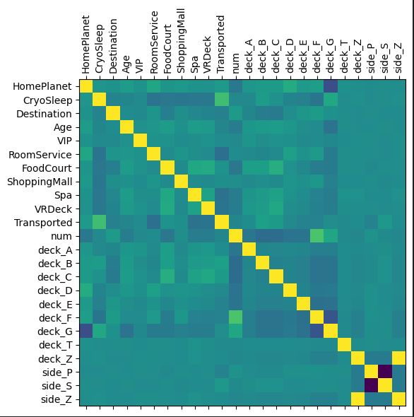

Slide 6


Accomplishing Model Training With Multiple Algorithms
Team members took responsibility for training multiple models
GridSearchCV technique used for hyperparameter tuning
Using both parametric and non-parametric algorithms to avoid duplication
Aiming to identify the optimal combination of hyperparameters that yielded the best performance
Through careful model training and hyperparameter tuning, the team was able to identify the optimal combination of hyperparameters that yielded the best performance for each model.

Slide 7
Models Implemented
Logistic Regression
Logistic regression is a statistical model used for binary classification, where the output is a probability between 0 and 1.
It provides probability estimates for positive class membership, interpreting class labels (0 or 1) as probabilities.
Evaluation metrics such as accuracy, precision, recall, and F1-score assess model performance.
Logistic regression coefficients offer interpretability, enabling the understanding of each feature's impact on the predicted outcome. Analyzing the coefficients can provide insights into the influential features in determining the class label.
It serves as a baseline model for performance comparison and offers a simple benchmark for evaluation.
Logistic regression is computationally efficient, handling high-dimensional datasets effectively.

Slide 8
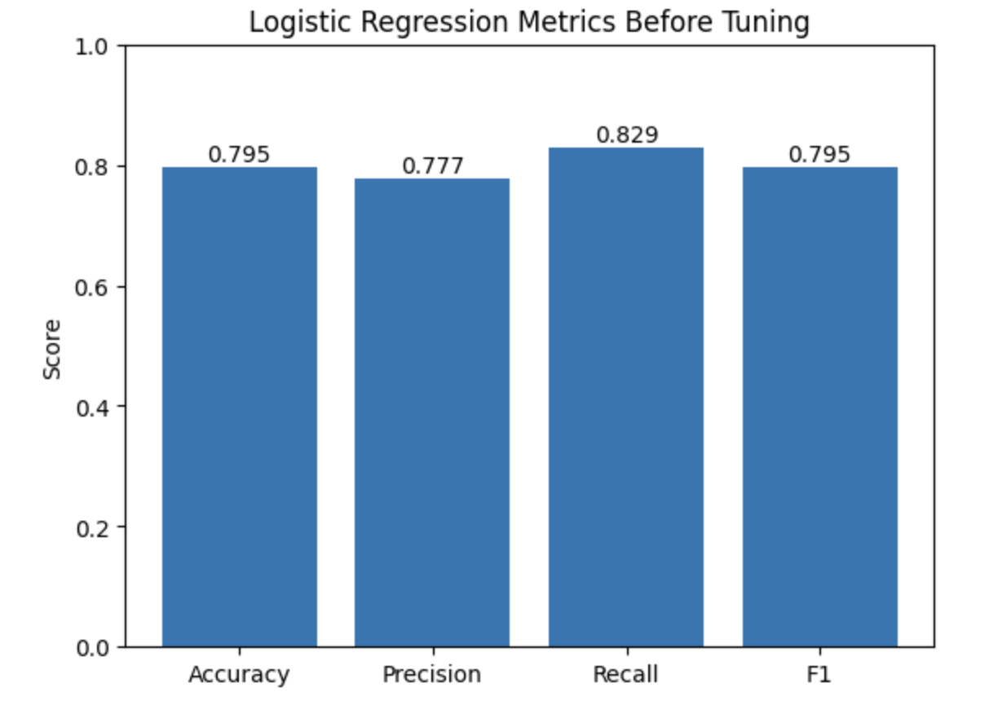
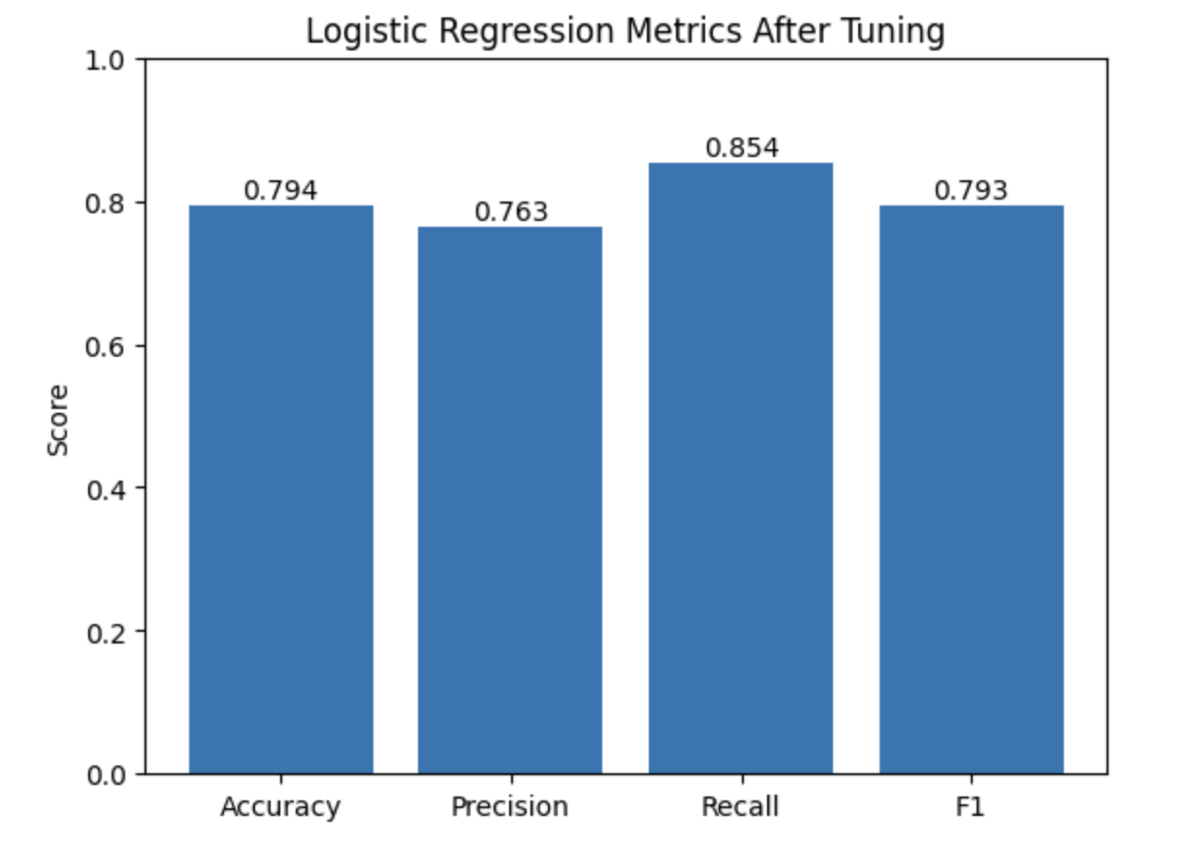
A higher recall after tuning the model with GridSearch suggest that the model is performing well in terms of correctly identifying positive instances (high recall)

Slide 9
Models Implemented
Gaussian Naïve Bayes Classifier
Gaussian NB is suitable when the features in the dataset follow a Gaussian distribution.
It assumes independence between features given the class variable, simplifying the modeling process.
Gaussian NB provides probabilistic classification, estimating the likelihood of an instance belonging to each class.
It is a fast and computationally efficient algorithm, requiring fewer resources compared to complex models.
Gaussian NB handles continuous features well due to its assumption of a Gaussian distribution.
The algorithm offers interpretability by analyzing mean and standard deviation to understand feature importance.

Slide 10
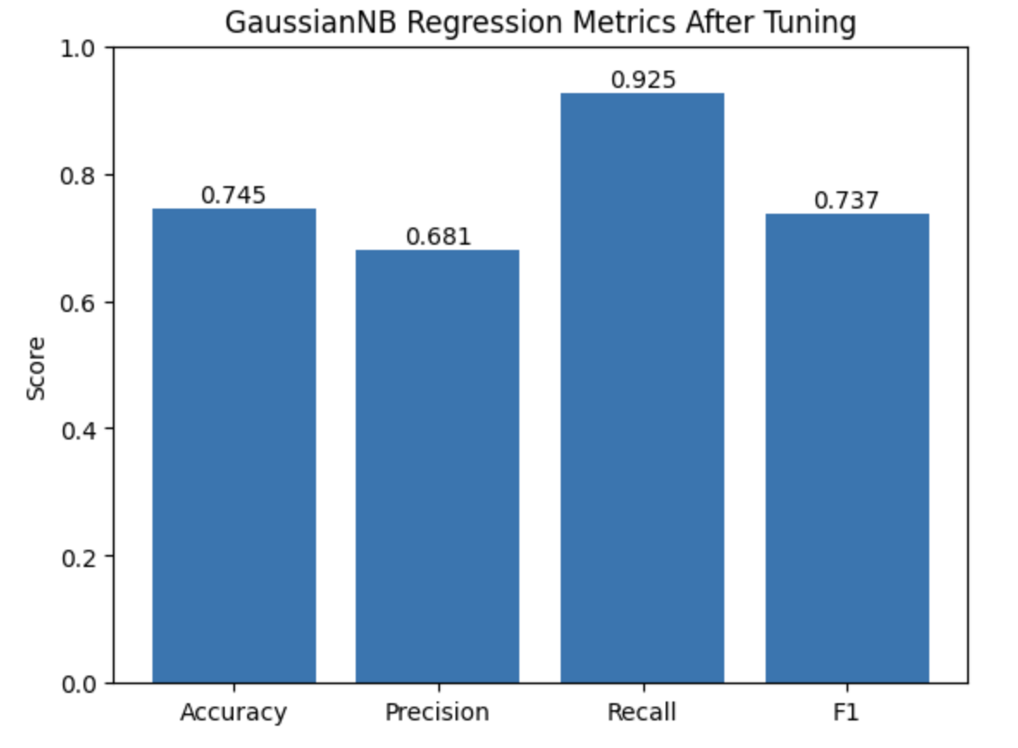
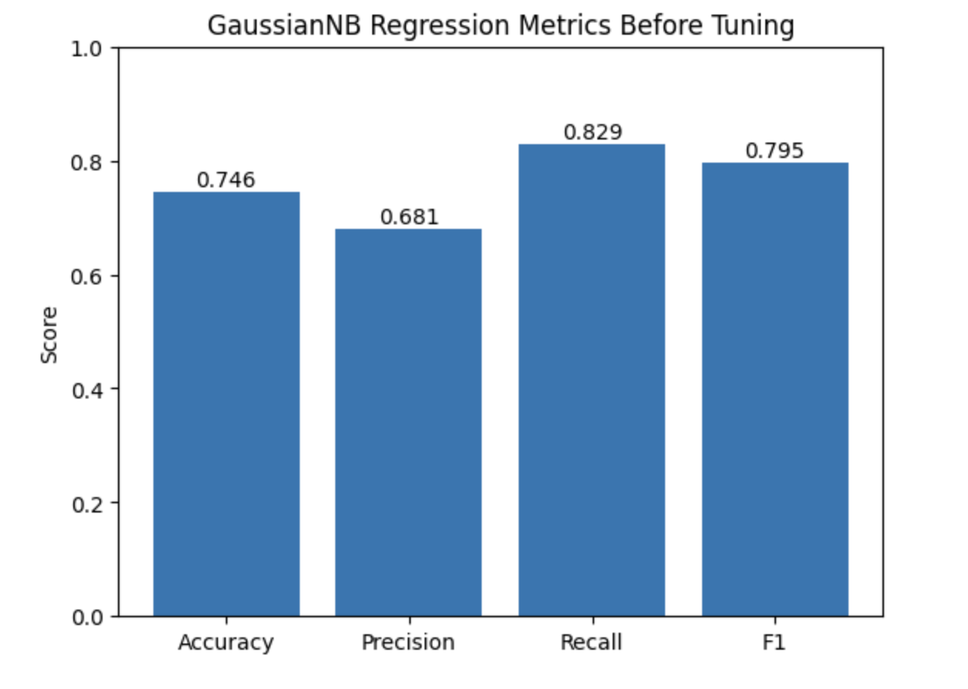
A higher recall after tuning the model with GridSearch suggest that the model is performing well in terms of correctly identifying positive instances (high recall)

Slide 11
Models Implemented
Linear Discriminant Analysis (LDA)
LDA can be used for dimensionality reduction, finding a linear combination of features that maximizes class separation while minimizing within-class variance.
It is also a classification algorithm, modeling feature distributions and using Bayes' theorem for posterior probability calculation.
LDA handles multicollinearity among features by considering the relationship between features and the target variable.
Interpretability is provided through analyzing coefficients or discriminant vectors, revealing feature contributions to class separation.
LDA works best when classes have approximately equal covariance matrices and balanced within-class variances.
LDA assumes linear decision boundaries, so it may not perform well if the relationship between features and the target is complex and nonlinear.

Slide 12
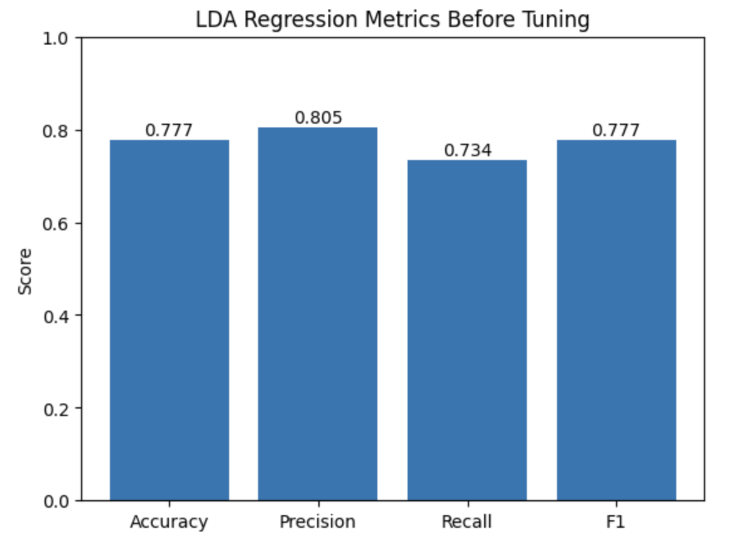
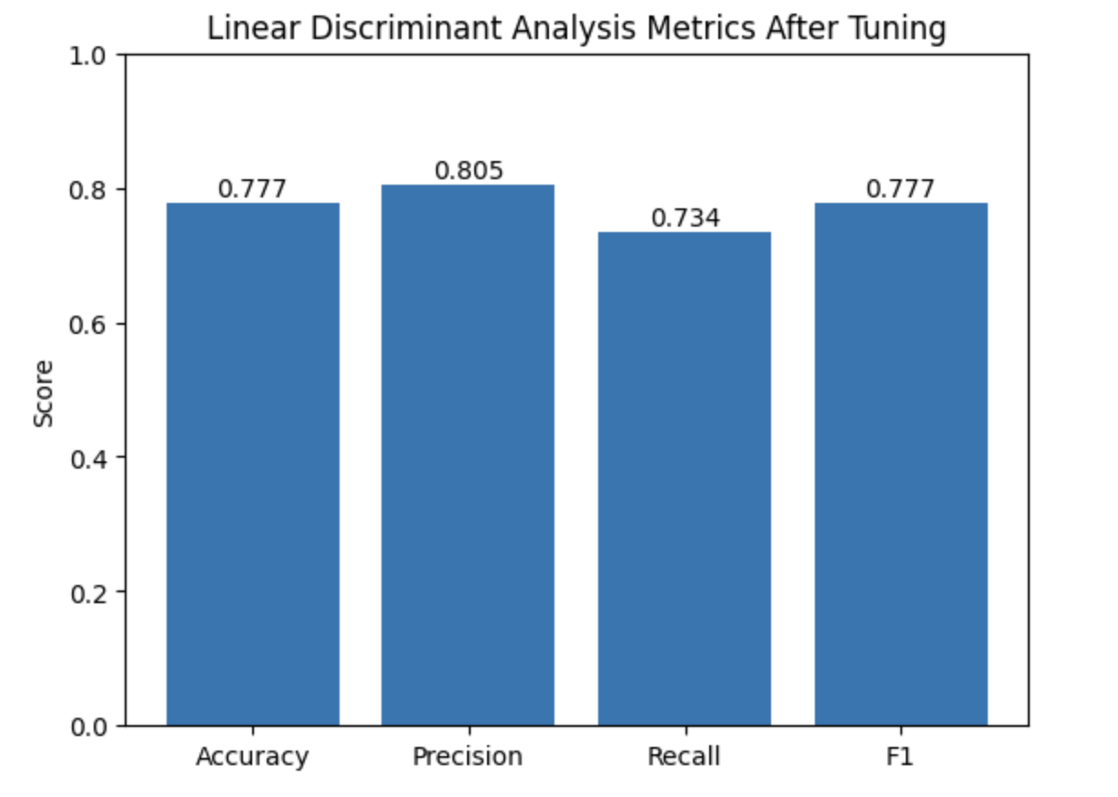

Slide 13
Models Implemented
Decision Tree Classifier (DTC)
Decision trees are interpretable, capturing nonlinear relationships and providing clear decision rules.
They offer feature importance measures for feature selection and insights into the data.
Decision trees can handle missing values and outliers, accommodating datasets with incomplete information.
They do not assume specific data distributions, making them suitable for both categorical and numerical features.
Decision trees can be used as building blocks for ensemble methods like random forests and gradient boosting.
Training decision trees is computationally efficient, particularly for smaller datasets, with logarithmic time complexity.

Slide 14
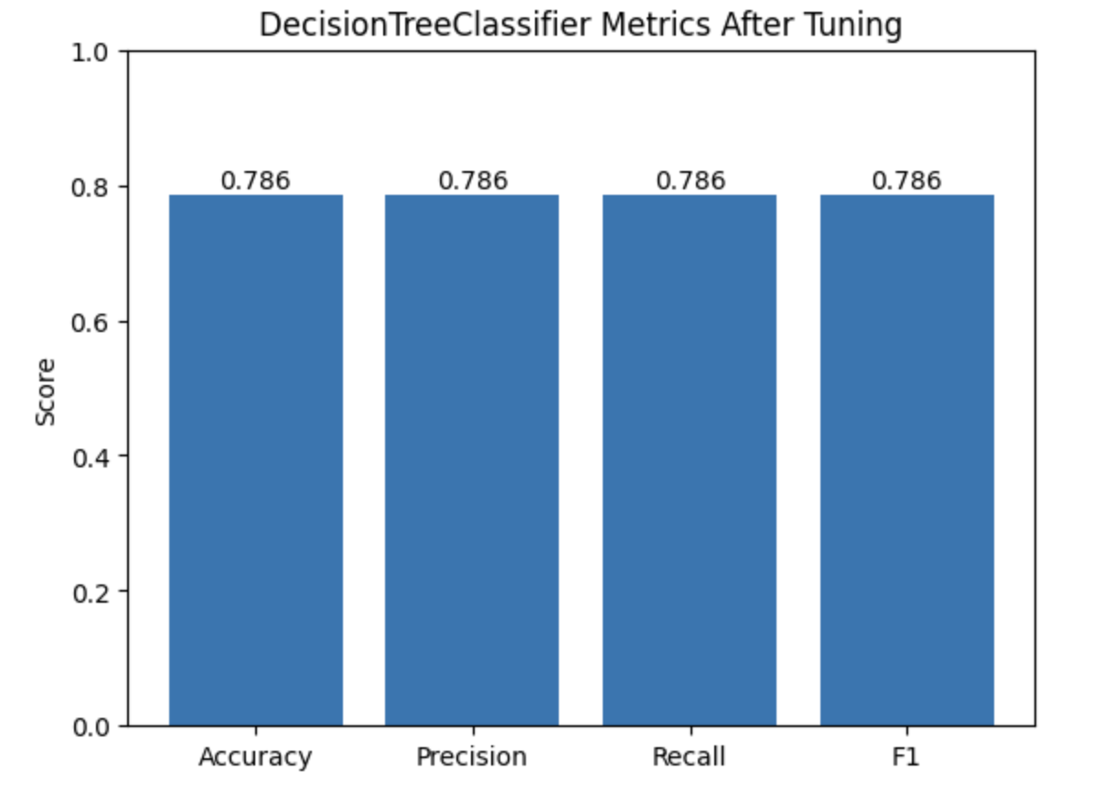
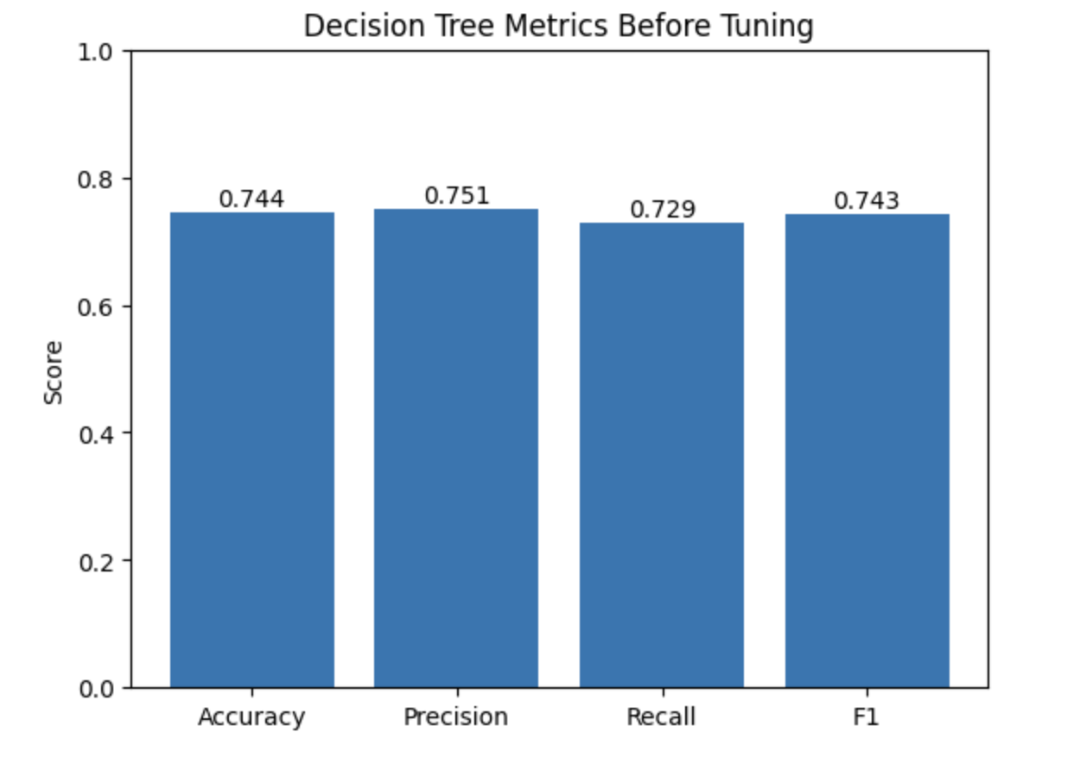
Overall perfomance was slightly increased after tuning the mode

Slide 15
Models Implemented
Random Forest Classifier
Random Forest combines multiple decision trees, reducing variance and improving overall performance.
It mitigates overfitting by aggregating predictions from different trees and considering random subsets of features.
Random Forests provide feature importance measures for feature selection and gaining insights into the data.
They effectively capture nonlinear relationships and handle complex decision boundaries and feature interactions.
Random Forest can handle missing values and scales well for large datasets.
No assumptions are made about data distribution or feature type.

Slide 16
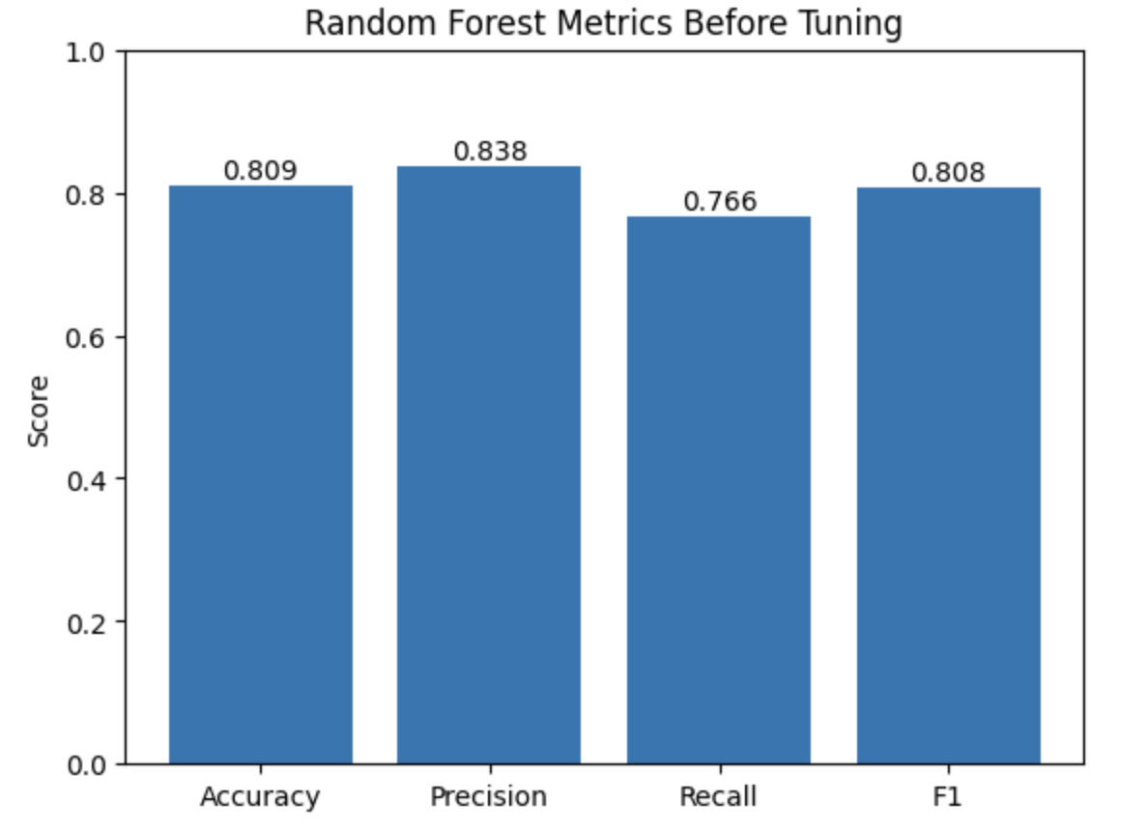
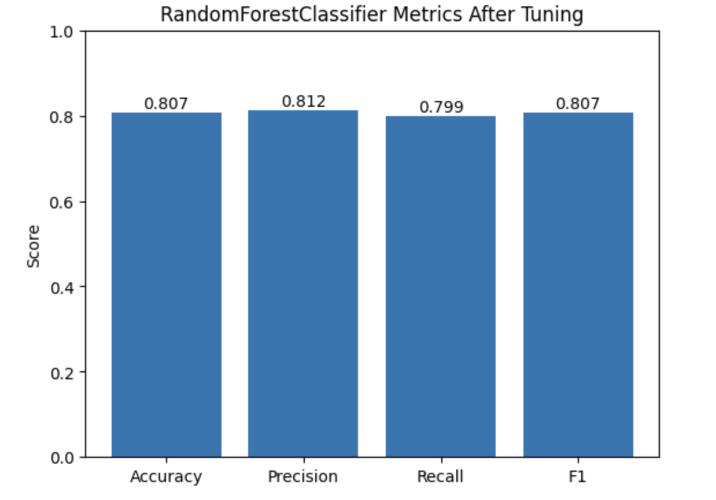
A higher recall after tuning the model with GridSearch suggest that the model is performing well in terms of correctly identifying positive instances (high recall)

Slide 17
Models Implemented
Gradient Boosting Classifier
Gradient Boosting combines weak learners to create a strong predictive model iteratively.
It excels in capturing complex relationships and nonlinear patterns in the data.
Gradient Boosting strikes a balance between bias and variance, reducing underfitting and overfitting.
Feature importance measures help identify the most influential features and gain insights.
It handles missing values using surrogate splits and is robust to noisy data and outliers.
Gradient Boosting leverages ensemble learning for improved accuracy and robustness.
The algorithm is scalable and efficient for large datasets and can be parallelized.

Slide 18
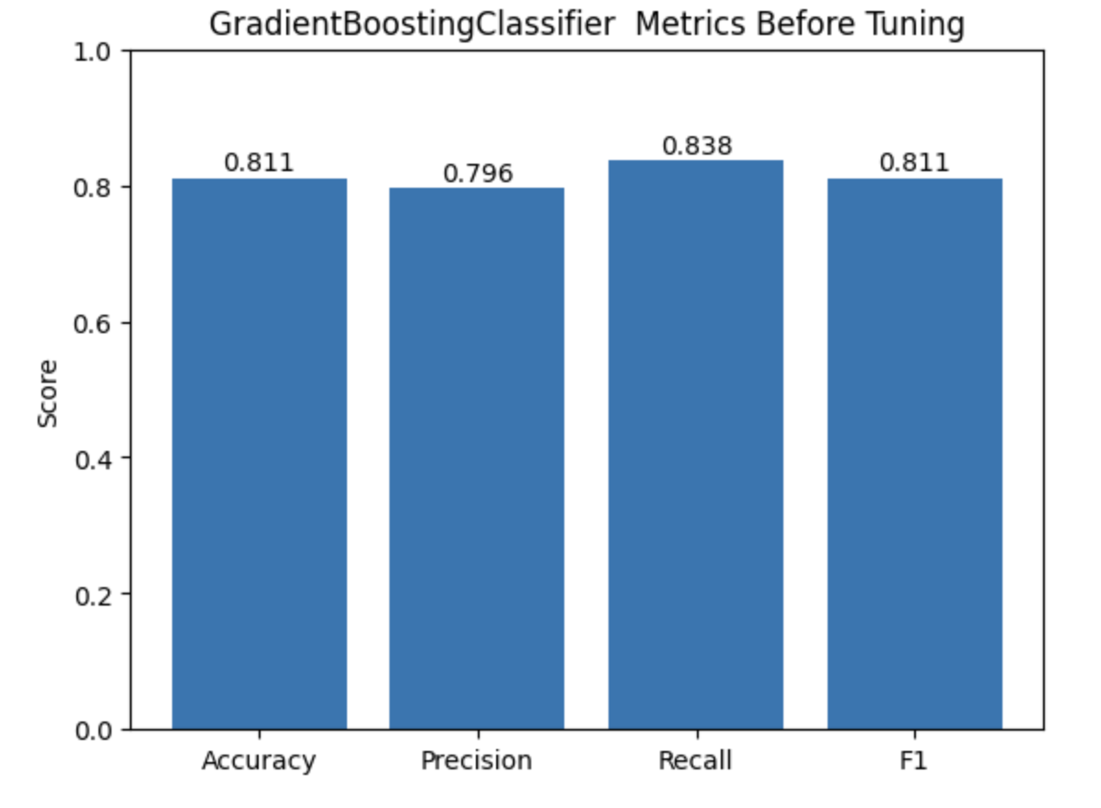
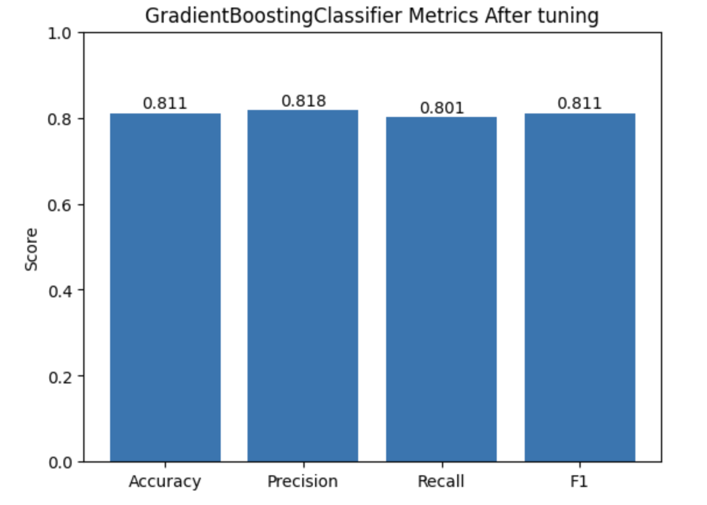
The tuned model has a better balance between accuracy precision and recall

Slide 19
Stacked
Meta-Model
Stacked Model
Stacking is an ensemble learning technique that combines multiple base models with a meta-model.
The Stacking Classifier in scikit-learn combines base estimators with a final estimator.
Base estimators make individual predictions, and the final estimator combines them for the final prediction.
Meta-model training involves training base estimators on the training set and creating meta-features.
Cross-validation is performed to assess performance and generalization.
The stacking method for combining predictions is automatically determined.
Parallel processing is used to speed up training with multiple CPU cores.
Predictions are made on the validation and test sets, and accuracy is evaluated using the accuracy_score function.

Slide 20
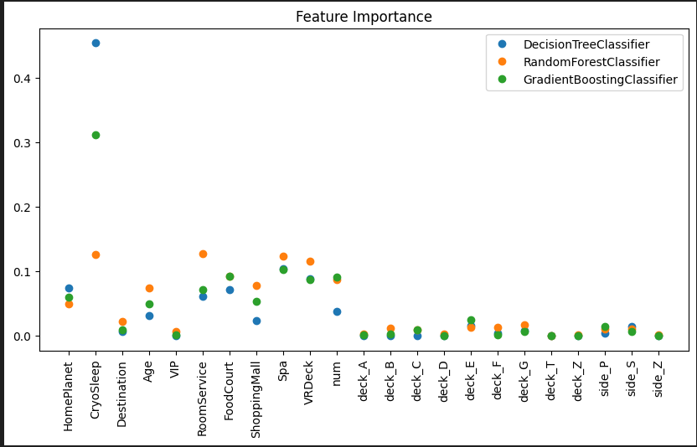

Slide 21
Conclusion
Model | Accuracy on Test Set
Logistic Regression | 0.794
Gaussian Naïve Bayes | 0.745
LDA | 0.777
Decision Tree Classifier | 0.786
Random Forest Classifier | 0.807
Gradient Boosting Classifier | 0.811
Stacked Model #1 Stacked Model #2 | 0.815 0.814

Slide 22
Thank you!

